Slide 1

Insight of Airline Customer Value Analysis Using K-Means Model
MUTHIA AISYAH PUTRI

Slide 2
SUBTOPIC
About the data
The way to process the data
The conclusion and evaluation of the chosen model.

Slide 3
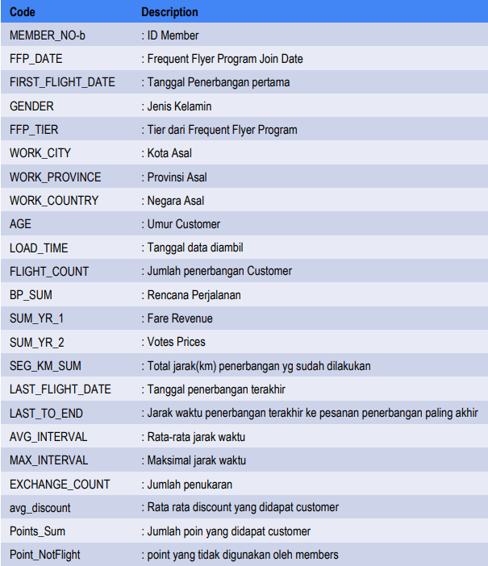
About The Data
This data contains the basic flight information, and point information of 62,988 customers. It contains the membership card number, membership time, gender, age, membership card level, and mileage in the observation window. 44 characteristic attributes such as number and flight time.
Source: https://www.programmersought.com/article/48113472881/

Slide 4
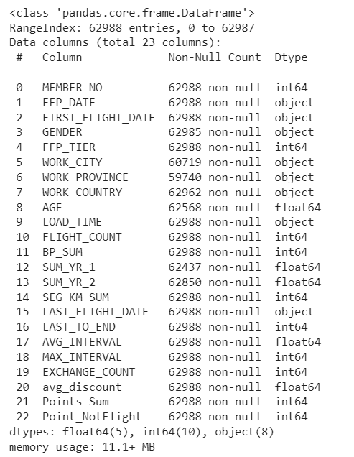
1. Data Pre-processing
Observation:
There are some columns that are unrelated to the data. It will be dropped.
All the columns that contain dates are still an object in dtype.
There are missing values that have to be handled.

Slide 5
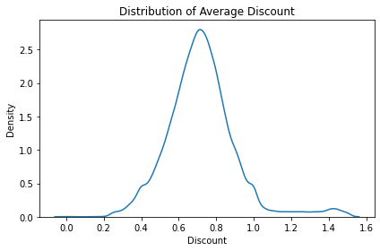
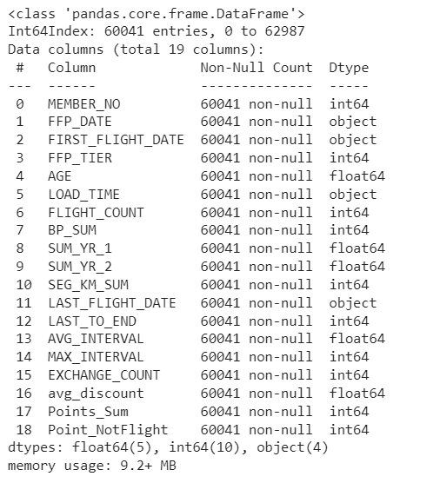
1. Data Pre-processing
Observation:
Handling missing values done.
Some average discounts have larger than 100%, it dropped.
There is no duplicated data.

Slide 6
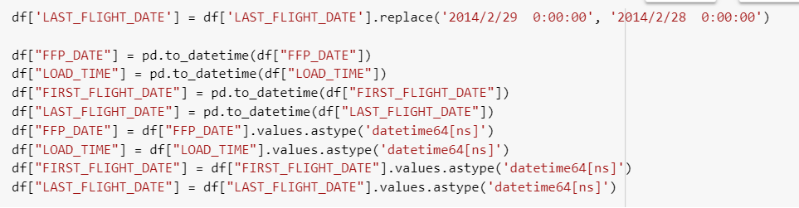
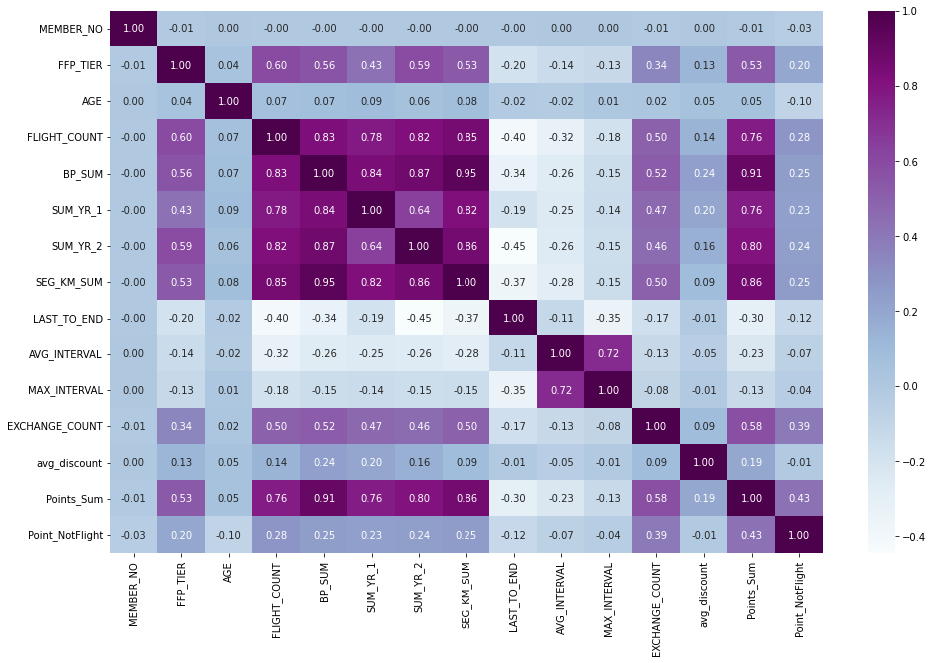
1. Data Pre-processing
Observation:
Handling dates data done.
Some columns have a large correlation with another column.
Point_sum
BP_SUM
SUM_YR2
SUM_YR1
FLIGHT_COUNTS
SEG_KM_SUM

Slide 7
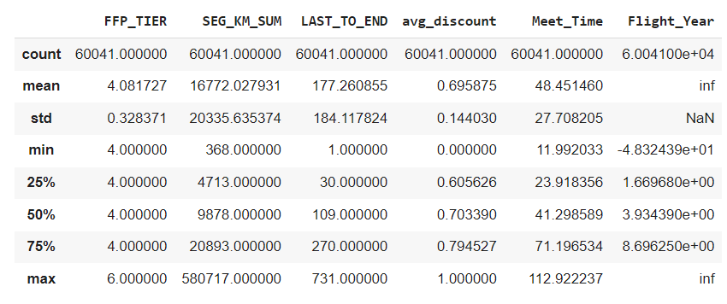
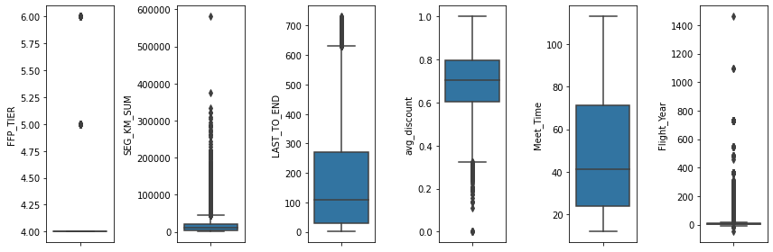
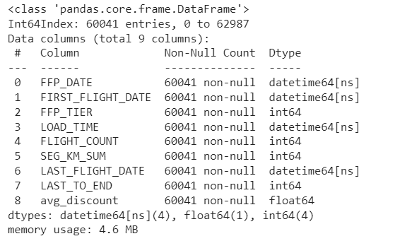
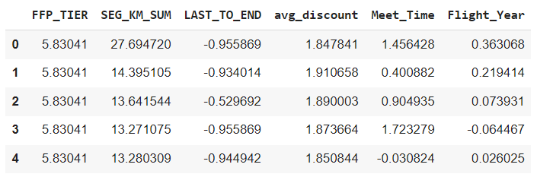
2. Feature selection
Observation:
All the dates data is converted to numerical data meet_time (how long being a customer) and Flight_Year (number of flights per year)
Some columns that are unrelated dropped. Chosen 1 column that has a large correlation.
Scaling and standardization done.

Slide 8
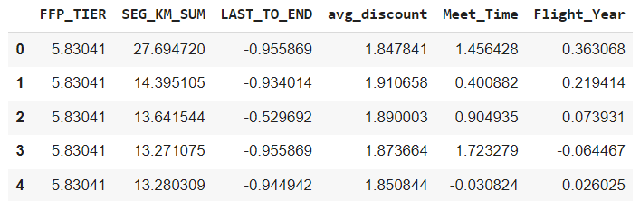
2. Feature selection

Slide 9
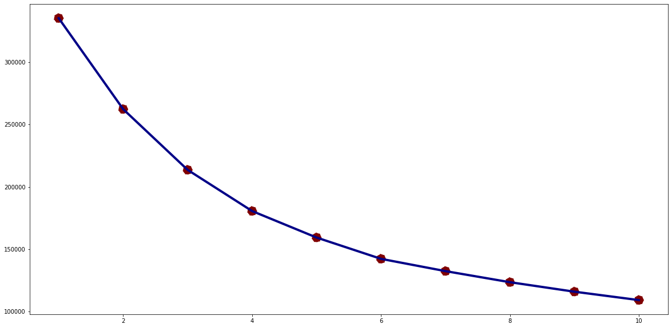
3. Modelling
Observation:
The model used is K-Means Model.
From the inertia, the number starts to slowly decrease when 4 clusters. So, we going to use 4 clusters.

Slide 10
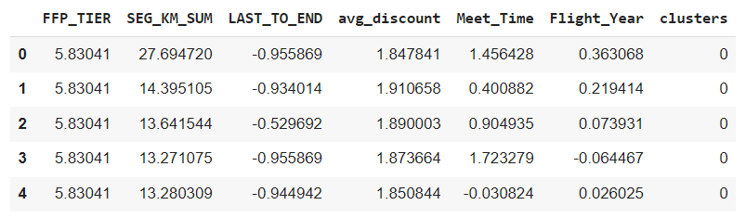
3. Modelling
K-MEANS MODEL WITH 4 CLUSTERS.

Slide 11
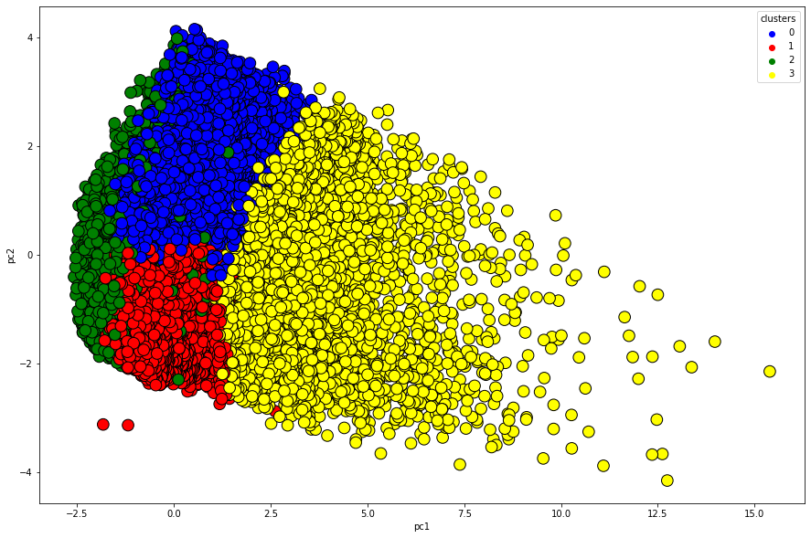
3. Modelling
Visualization with PCA to make it 2D and easier to interpret.

Slide 12
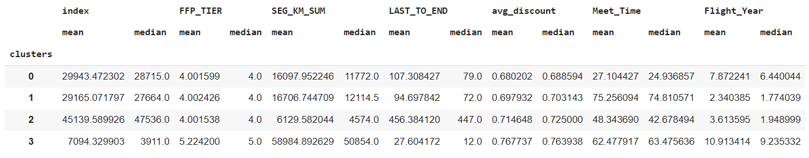
4. Clusters Interpretation
Interpretation:
Cluster 0. New customers (around 27 months) with the least average discounts (around 68%).
Cluster 1. Customers with the least number of flights per year (around 2 times) but they are old customers (around 75 months).
Cluster 2. Customers who haven't made a flight for a long time and classified as new customers (around 48 months).
Cluster 3. Customers with the farthest total flight distance (around 50000km) with the biggest number of flights per year (around 10).

Slide 13
4. Insight
The discount given can be based on the length of time being a customer and also the number of flights made per year.
Based on data, old customers who fly a lot per year are much fewer than those who fly a little per year (around 2 per year). This can be improved by providing more services and offerings, one of which is a discount.
the number of new customers can be maintained or increased, as it can be seen that new customers tend to make many flights per year.

